Slide 1

DriverPass System Analysis
Jorgo Qendro
Notes:
[No speaker notes required for this slide.]

Slide 2

System Requirements
Functional Requirements:
The system must allow users (students and secretaries) to make, cancel, and modify driving lesson reservations online or by phone.
The system must track which driving instructor, vehicle, and timeslot are assigned to each student’s reservation, ensuring proper scheduling and updates.
Nonfunctional Requirements:
The system must be accessible via the web on both mobile devices and computers, ensuring data can be viewed online but only modified when connected to the internet.
The system must provide different levels of user access based on roles (e.g., admin, IT officer, secretary) with appropriate permissions for each.
Notes:
[In your speaker notes, include an explanation of the different requirements you determined for DriverPass’s system. What are the functional requirements you selected to describe? What are the nonfunctional requirements you selected to describe? Be sure to explain how these requirements meet DriverPass’s needs.]

Slide 3
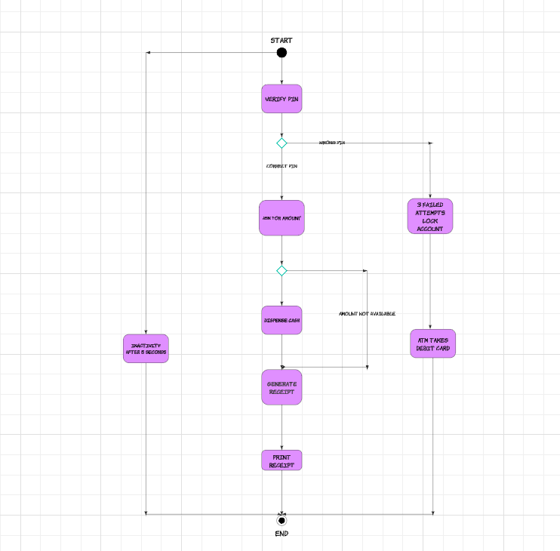
Use Case Diagram
Notes:
[Explain your diagram. Who are the different actors in the system? What are the different use cases? How did you account for DriverPass’s needs in your design? In your explanation, keep your audience in mind. Avoid the use of terms like “actors” and “use cases” in your explanation.]

Slide 4
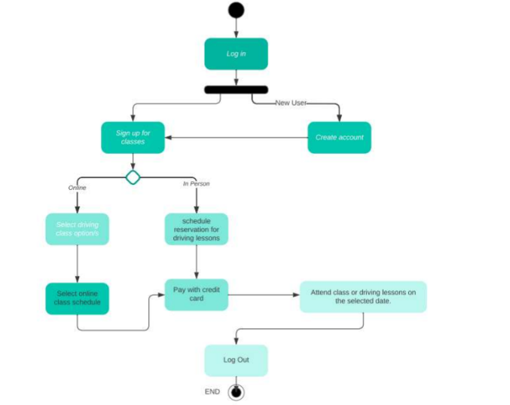
Activity Diagram
Notes:
[Explain your diagram. Which use case are you breaking down? What are the steps for this use case? How did you account for DriverPass’s needs in your design? In your explanation, keep your audience in mind. Avoid the use of technical terms such as “nodes,” “control flows,” and so on.]

Slide 5
Security
Security Considerations for DriverPass:
Role-based access control: Different levels of access for admin (Liam), IT officer (Ian), secretaries, and students.
Password management: The system includes a password reset option for users who forget their credentials.
Tracking and logging: Every action taken in the system (e.g., reservations, modifications, cancellations) is tracked with a timestamp and associated user information.
Data encryption: All sensitive information, including student personal data and payment information, is stored and transmitted using encryption.
Integration with DMV: Ensure secure communication channels for syncing updates from the DMV regarding test requirements and policies.
Notes:
[How did you consider security in your design? In your explanation, keep your audience in mind by avoiding the use of technical terms.]

Slide 6
System Limitations
No offline updates: Data cannot be modified offline; users must be online to make any changes to avoid duplication or redundancy.
Package management flexibility: Although packages can be disabled, adding or removing new ones will require developer intervention, limiting the client's flexibility without technical support.
Single DMV integration: The system relies on an external connection to the DMV for updates, which may lead to delays if the DMV's system experiences issues.
Scalability concerns: While the system is designed for current operations, future scaling (e.g., adding more vehicles, drivers, or locations) may require significant system updates.
Notes:
[What are the limitations of your design? In your explanation, keep your audience in mind by avoiding the use of technical terms.]

